Slide 1

Bank Loan Finance Portfolio Presentation and Analysis
Analysis of Loan Data where this analysis aims to identify trends, risk factors, and patterns in loan defaults, as well as to propose actionable recommendations for improving loan approval processes and minimizing default rates.
By Rounak Pyne

Slide 2
Objective:
The primary goal of this project is to analyze loan data from a bank to gain insights into the lending process, understand the risk factors associated with loans, and develop strategies to enhance the bank's loan portfolio performance. This analysis aims to identify trends, risk factors, and patterns in loan defaults, as well as to propose actionable recommendations for improving loan approval processes and minimizing default rates. This report aims to provide insights into key loan-related metrics and their changes over time. The report will help us make data-driven decisions, track our loan portfolio's health, and identify trends that can inform our lending strategies.

Slide 3
Data Description:
Data Source: Loan data with various attributes related to borrower and loan characteristics.
Attributes: Loan ID, Address State, Employee Length, Employee Title, Grade, Sub Grade, Home Ownership, Issue Date, Last Credit Pull Date, Last Payment Date, Loan Status, Next Payment Date, Purpose, Term, Verification Status, Annual Income, DTI, Instalment, Interest Rate, Loan Amount.

Slide 4
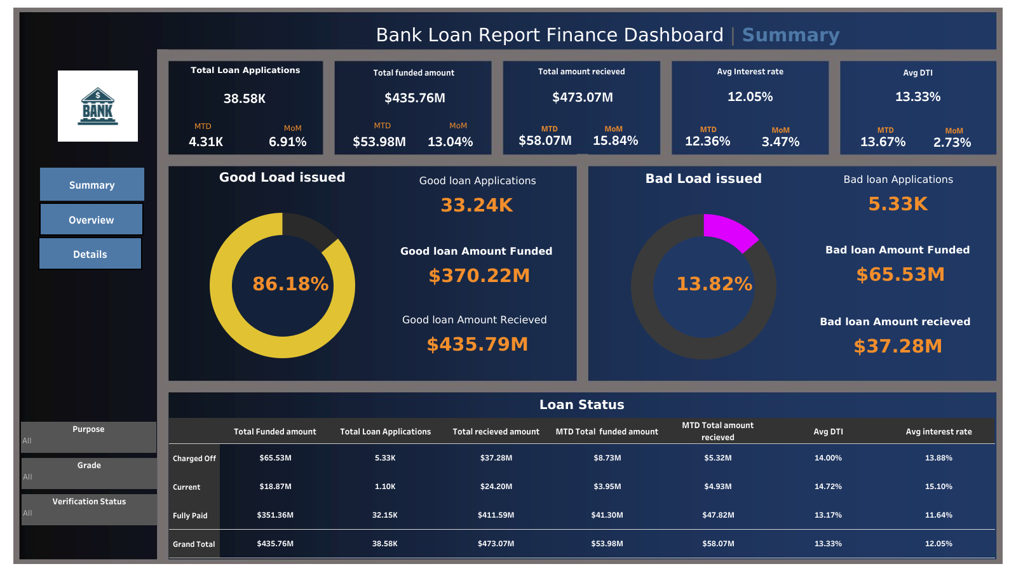
Dashboard Overview Summary:

Slide 5
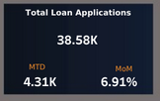
Key Performance Indicators (KPIs) Requirements:
Total Loan Applications
Calculate total applications received during a specified period.
Monitor Month-to-Date (MTD) applications.
Track Month-over-Month (MoM) changes.

Slide 6
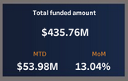
Key Performance Indicators (KPIs) Requirements:
Total Funded Amount
Calculate the total funds disbursed as loans.
Monitor MTD funded amounts.
Analyze MoM changes.

Slide 7
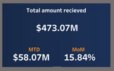
Key Performance Indicators (KPIs) Requirements:
Total Amount Received
Track the total amount received from borrowers.
Assess MTD received amounts.
Observe MoM changes..

Slide 8
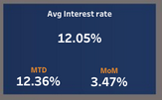
Key Performance Indicators (KPIs) Requirements:
Average Interest Rate
Calculate the average interest rate across all loans.
Monitor MTD interest rates.
Track MoM variations.

Slide 9
Good Loan v Bad Loan KPI’s:
In order to evaluate the performance of our lending activities and assess the quality of our loan portfolio, we need to create a comprehensive report that distinguishes between 'Good Loans' and 'Bad Loans' based on specific loan status criteria.
Good Loan KPIs:
1. Good Loan Application Percentage: We need to calculate the percentage of loan applications classified as 'Good Loans.' This category includes loans with a loan status of 'Fully Paid' and 'Current.’
2. Good Loan Applications: Identifying the total number of loan applications falling under the 'Good Loan' category, which consists of loans with a loan status of 'Fully Paid' and 'Current.’
3. Good Loan Funded Amount: Determining the total amount of funds disbursed as 'Good Loans.' This includes the principal amounts of loans with a loan status of 'Fully Paid' and 'Current.’
4. Good Loan Total Received Amount: Tracking the total amount received from borrowers for 'Good Loans,' which encompasses all payments made on loans with a loan status of 'Fully Paid' and 'Current.'

Slide 10
Good Loan v Bad Loan KPI’s:
In order to evaluate the performance of our lending activities and assess the quality of our loan portfolio, we need to create a comprehensive report that distinguishes between 'Good Loans' and 'Bad Loans' based on specific loan status criteria.
Bad Loan KPIs:
Bad Loan Application Percentage: Calculating the percentage of loan applications categorized as 'Bad Loans.' This category specifically includes loans with a loan status of 'Charged Off.’
Bad Loan Applications: Identifying the total number of loan applications categorized as 'Bad Loans,' which consists of loans with a loan status of 'Charged Off.’
Bad Loan Funded Amount: Determining the total amount of funds disbursed as 'Bad Loans.' This comprises the principal amounts of loans with a loan status of 'Charged Off.’
Bad Loan Total Received Amount: Tracking the total amount received from borrowers for 'Bad Loans,' which includes all payments made on loans with a loan status of 'Charged Off.'

Slide 11
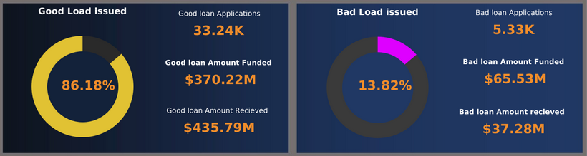

Good Loan v Bad Loan KPI’s:

Slide 12
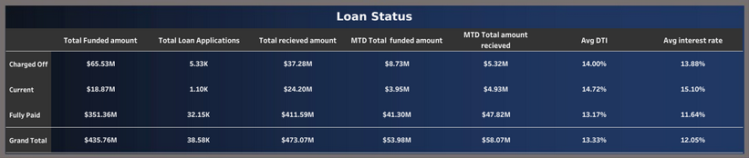
Loan Status Grid View:
In order to gain a comprehensive overview of our lending operations and monitor the performance of loans, we aim to create a grid view report categorized by 'Loan Status.' This report will serve as a valuable tool for analyzing and understanding the key indicators associated with different loan statuses. By providing insights into metrics such as 'Total Loan Applications,' 'Total Funded Amount,' 'Total Amount Received,' 'Month-to-Date (MTD) Funded Amount,' 'MTD Amount Received,' 'Average Interest Rate,' and 'Average Debt-to-Income Ratio (DTI),' this grid view will empower us to make data-driven decisions and assess the health of our loan portfolio.

Slide 13
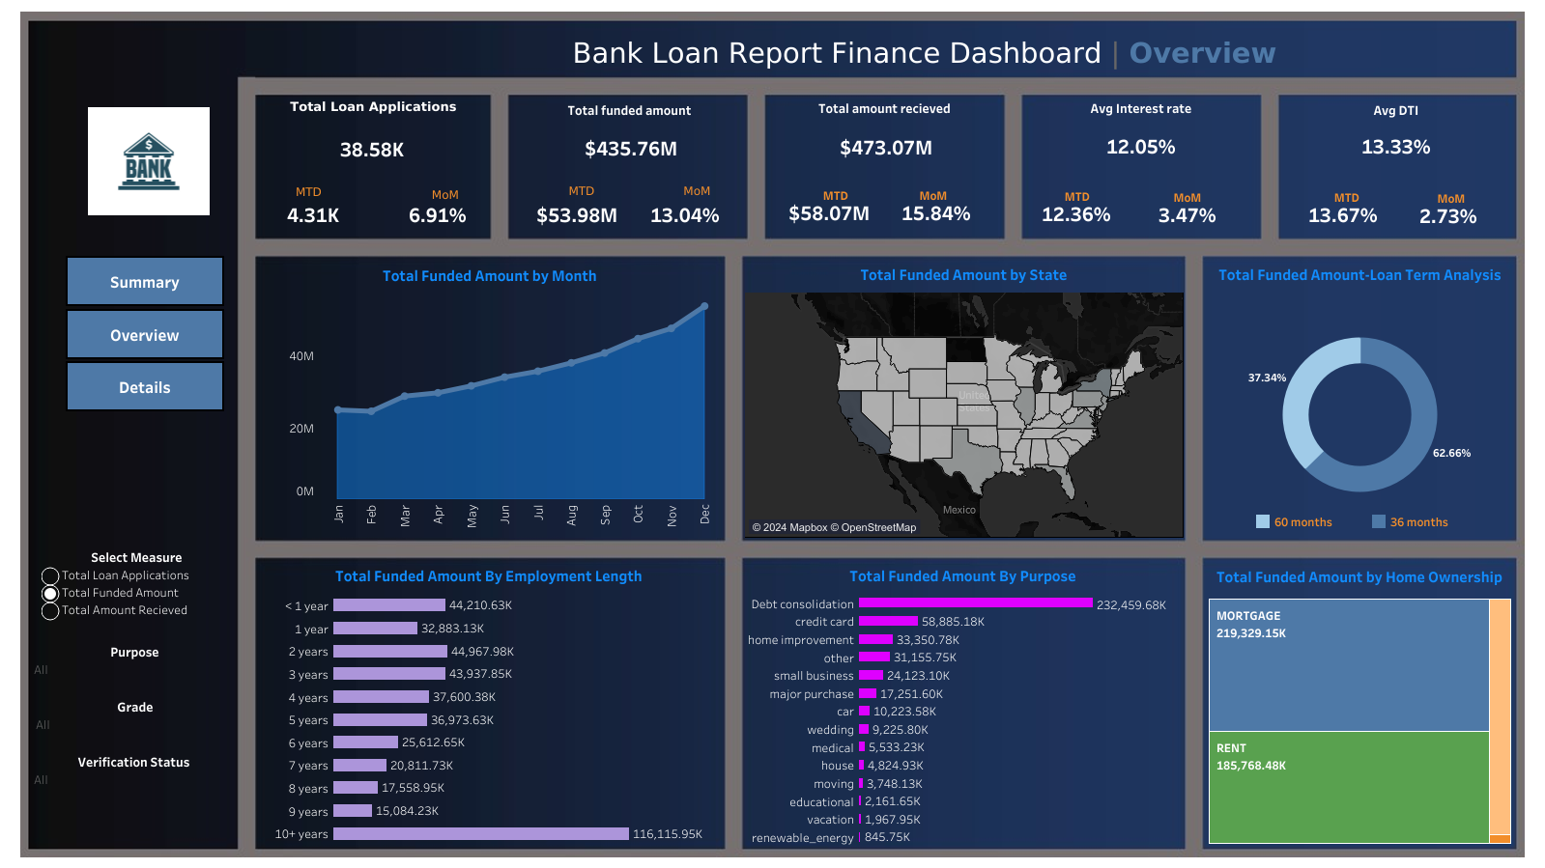
DASHBOARD 2: OVERVIEW

Slide 14
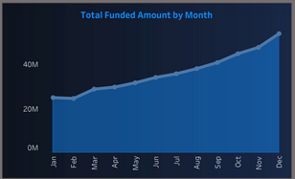
Total Amount funded by month:
In our Bank Loan Report project, we aim to visually represent critical loan-related metrics and trends using a variety of chart types. These charts will provide a clear and insightful view of our lending operations, facilitating data-driven decision-making and enabling us to gain valuable insights into various loan parameters. Below are the specific chart requirements:
Monthly Trends by Issue Date (Line Chart): Chart Type: Line Chart Metrics: 'Total Loan Applications,' 'Total Funded Amount,' and 'Total Amount Received' X-Axis: Month (based on 'Issue Date') Y-Axis: Metrics' Values
Objective: This line chart will showcase how 'Total Loan Applications,' 'Total Funded Amount,' and 'Total Amount Received' vary over time, allowing us to identify seasonality and long-term trends in lending activities.

Slide 15
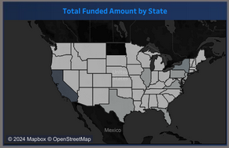
Total Amount funded by state:
In our Bank Loan Report project, we aim to visually represent critical loan-related metrics and trends using a variety of chart types. These charts will provide a clear and insightful view of our lending operations, facilitating data-driven decision-making and enabling us to gain valuable insights into various loan parameters. Below are the specific chart requirements:
Regional Analysis by State (Filled Map):
Chart Type: Filled Map Metrics: 'Total Loan Applications,' 'Total Funded Amount,' and 'Total Amount Received'
Geographic Regions:
States Objective: This filled map will visually represent lending metrics categorized by state, enabling us to identify regions with significant lending activity and assess regional disparities.

Slide 16
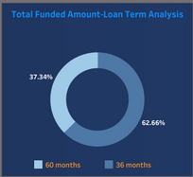
Loan Term Analysis (Donut Chart):
In our Bank Loan Report project, we aim to visually represent critical loan-related metrics and trends using a variety of chart types. These charts will provide a clear and insightful view of our lending operations, facilitating data-driven decision-making and enabling us to gain valuable insights into various loan parameters. Below are the specific chart requirements:
Loan Term Analysis (Donut Chart):
Chart Type: Donut Chart Metrics: 'Total Loan Applications,' 'Total Funded Amount,' and 'Total Amount Received' Segments: Loan Terms (e.g., 36 months, 60 months) Objective: This donut chart will depict loan statistics based on different loan terms, allowing us to understand the distribution of loans across various term lengths.

Slide 17
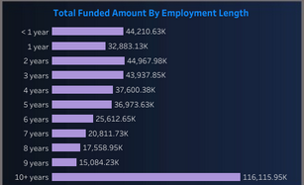
Employee Length Analysis (Bar Chart):
In our Bank Loan Report project, we aim to visually represent critical loan-related metrics and trends using a variety of chart types. These charts will provide a clear and insightful view of our lending operations, facilitating data-driven decision-making and enabling us to gain valuable insights into various loan parameters. Below are the specific chart requirements:
Employee Length Analysis (Bar Chart):
Chart Type: Bar Chart Metrics: 'Total Loan Applications,' 'Total Funded Amount,' and 'Total Amount Received' X-Axis: Employee Length Categories (e.g., 1 year, 5 years, 10+ years) Y-Axis: Metrics' Values Objective: This bar chart will illustrate how lending metrics are distributed among borrowers with different employment lengths, helping us assess the impact of employment history on loan applications.

Slide 18
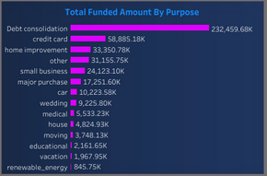
Loan Purpose Breakdown (Bar Chart):
In our Bank Loan Report project, we aim to visually represent critical loan-related metrics and trends using a variety of chart types. These charts will provide a clear and insightful view of our lending operations, facilitating data-driven decision-making and enabling us to gain valuable insights into various loan parameters. Below are the specific chart requirements:
Loan Purpose Breakdown (Bar Chart):
Chart Type: Bar Chart Metrics: 'Total Loan Applications,' 'Total Funded Amount,' and 'Total Amount Received' X-Axis: Loan Purpose Categories (e.g., debt consolidation, credit card refinancing) Y-Axis: Metrics' Values Objective: This bar chart will provide a visual breakdown of loan metrics based on the stated purposes of loans, aiding in the understanding of the primary reasons borrowers seek financing.

Slide 19
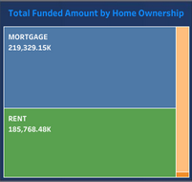
Home Ownership Analysis (Tree Map):
In our Bank Loan Report project, we aim to visually represent critical loan-related metrics and trends using a variety of chart types. These charts will provide a clear and insightful view of our lending operations, facilitating data-driven decision-making and enabling us to gain valuable insights into various loan parameters. Below are the specific chart requirements:
Chart Type: Tree Map Metrics: ‘Total Loan Applications,' 'Total Funded Amount,' and 'Total Amount Received' Hierarchy: Home Ownership Categories (e.g., own, rent, mortgage)
Objective: This tree map will display loan metrics categorized by different home ownership statuses, allowing for a hierarchical view of how home ownership impacts loan applications and disbursements. These diverse chart types will enhance our ability to visualize and communicate loan-related insights effectively, supporting data-driven decisions and strategic planning within our lending operations."

Slide 20
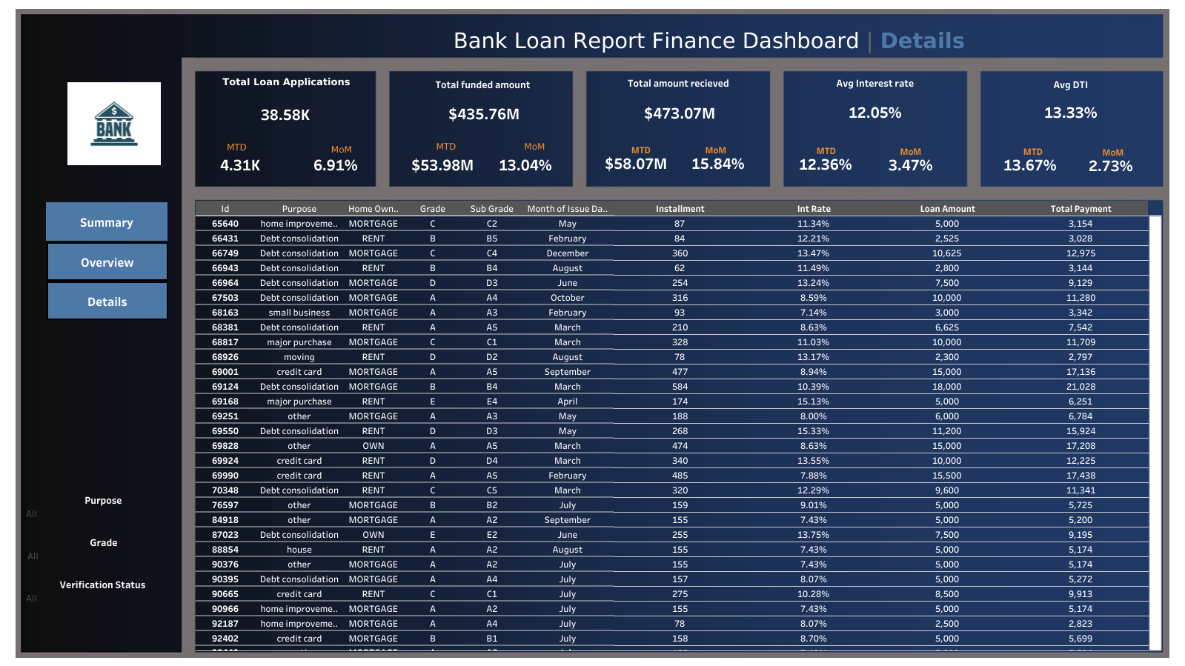
DASHBOARD 3: DETAILS

Slide 21
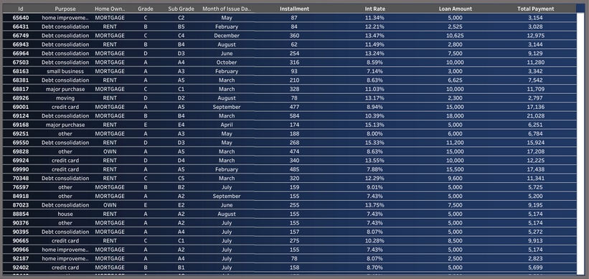
DASHBOARD 3: DETAILS
In our Bank Loan Report project, we recognize the need for a comprehensive 'Details Dashboard' that provides a consolidated view of all the essential information within our loan data. This Details Dashboard aims to offer a holistic snapshot of key loan-related metrics and data points, enabling users to access critical information efficiently.
Objective: The primary objective of the Details Dashboard is to provide a comprehensive and user-friendly interface for accessing vital loan data. It will serve as a one-stop solution for users seeking detailed insights into our loan portfolio, borrower profiles, and loan performance.

Slide 22
Summary :
The Analysis concludes that over the tenure total Amount disbursed was 435.76 million where the amount relieved was 473.07 million with an average interest rate of 12.05% .
Good Loan application looks good but needs to be increased with the upcoming years and bad loan has to decreased and has to kept below 5%.
Avg charged off interest rate is 13.88% where as current is 15.10%.
We see more people taking loan for 36 months with 62.56% which good but 60 months tenure needs attention .
We need to focus on people with 6-9 years employment as they can give a good turn over but are getting low fundings.
Medical, Car, Educational Loan takers are few which needs to focus on and increased with immediate actions.
The overall analysis says that the report is but there are sectors which needs work and have to implement new strategy as soon as possible.

Slide 23
Thank You
Rounak Pyne
rounakpyne.official@gmail.com

